Slide 1
Predictive Analytics and Dynamic Pricing in the Food and Beverage Industry
Restaurant Management and Data Analytics
Team No 15
Achyuth M(21EG110A01)
M Jayanth(21EG110A27)
P Koushik(22EG510A06)
Under the Guidance of
Mrs. G. Swapna
Assistant Professor
Dept. of Data Science

Slide 2
Overview of the Project
This project focuses on developing a data-driven web application for an Indian restaurant that leverages machine learning to optimize operations. The key components of the application include:
Demand Forecasting: Using decision tree regression, the application predicts the quantity of each menu item that will be ordered over the next week, helping the restaurant to plan inventory efficiently.
Dynamic Pricing: The application dynamically adjusts the pricing of menu items based on demand trends, ensuring competitive pricing for high-demand items while promoting lesser-demanded dishes.
Customer Pattern Analysis: The application identifies purchasing patterns based on customer demographics (such as gender and occupation), enabling targeted marketing and personalized offers.
Sales Ratio and Revenue Forecasting: It also provides insights into the sales ratio of vegetarian vs. non-vegetarian dishes and forecasts potential revenue for the upcoming week.
Web Application: The application is built using Flask, with a user-friendly interface that displays all predictions, analyses, and insights in a visually appealing manner.
This project not only enhances operational efficiency but also empowers the restaurant with actionable insights to drive growth and customer satisfaction.

Slide 3
Abstract
Objective: Develop a machine learning-based web application to predict weekly food orders, optimize pricing, and analyze customer purchasing patterns to enhance restaurant operations.
Data & Model:
Datasets: Transaction data including date, customer demographics, item details, and order quantities.
Model: Decision Tree Regression.
Preprocessing: Data cleaning, feature engineering, encoding categorical variables.
Web Application:
Framework: Flask backend, HTML/CSS frontend.
Features:
Demand Forecasting: Predicts the number of orders and quantity of each item for the next week.
Dynamic Pricing: Adjusts item prices based on demand trends.
Customer Analysis: Identifies patterns based on gender, occupation, and time of order.
Sales Insights: Analyzes sales ratios and forecasts revenue.
Data Visualization: Displays insights and forecasts in an interactive, user-friendly format.
Deployment:
Accessibility: Local web browser.
User-Friendly: Designed for easy interaction by restaurant managers.
Summary: The project delivers a comprehensive system for predicting food demand, dynamically adjusting prices, and understanding customer behavior, all through a visually engaging and easy-to-use web application.

Slide 4
Introduction
The Predictive Analytics and Dynamic Pricing System is designed to enhance supply chain management in the food and beverage industry by accurately forecasting food orders, optimizing inventory, and boosting customer satisfaction. Utilizing Decision Trees for machine learning, the system analyzes historical data and current meal details to make precise predictions. This predictive model is integrated into a web application built with Flask, HTML, and CSS, which offers functionalities such as forecasting food orders for the next 10 weeks, providing detailed insights on food by cuisine and category, analyzing demand for better inventory management, and allowing custom scenario predictions. The system also includes data visualization features to help stakeholders understand order distribution and key metrics. Deployed locally through a web browser, the application ensures an intuitive and user-friendly experience for all users.

Slide 5
Objective
Primary Objective
Goal: Develop a robust food demand forecasting system using machine learning and web technologies.
Key Objectives
Accurate Demand Prediction:
Implement machine learning algorithms.
Forecast demand for various food items.
Aid in efficient inventory and resource planning.
Optimized Inventory Management:
Predict quantities needed for each food item.
Minimize overstocking and stockouts.
Reduce inventory holding costs.
Enhanced Operational Efficiency:
Provide insights into future demand patterns.
Streamline operations and resource allocation.
Improved Customer Satisfaction:
Ensure availability of food items based on demand.
Reduce waiting times and ensure timely deliveries.

Slide 6
Existing Work & Limitation
Existing Work:
Traditional Forecasting Methods:
Basic Techniques: Simple models like moving averages and exponential smoothing are commonly used but often fail to capture complex demand patterns.
Manual Inventory Management: Many systems rely on manual processes, which are time-consuming and inefficient, especially for managing large and diverse product portfolios.
Limitations:
Limited Accuracy: Basic forecasting methods often struggle to accurately predict demand due to their inability to model complex, non-linear patterns.
Manual Processes: Dependence on manual input and adjustments leads to inefficiencies and errors in inventory management.
Lack of Scalability: Traditional approaches may not scale well with increasing data volume or evolving market conditions, making them less adaptable to changing demand patterns.

Slide 7
Proposed work & Advantages
Proposed Work:
Machine Learning Models: Employ advanced models such as Decision Trees for precise demand forecasting.
Predictive Analytics: Analyze patterns, trends, and seasonality to enhance food demand predictions.
Real-Time Updates: Offer real-time forecasts to enable timely adjustments in inventory management.
User-Friendly Interface: Provide an intuitive web interface for easy interaction and visualization of data.
Scalability and Adaptability: Ensure the system adapts to evolving business needs and fluctuating demand patterns.
Integration: Seamlessly connect with existing systems like inventory management and POS for streamlined operations.
Performance Evaluation: Continuously monitor and refine models to improve forecasting accuracy.
Advantages:
Enhanced Accuracy: Advanced models capture complex demand patterns for more accurate forecasts.
Efficiency: Automated processes reduce manual effort and improve operational efficiency.
Flexibility: Scalable and adaptable system meets changing business requirements and market conditions.
Real-Time Insights: Immediate updates support proactive inventory management and decision-making.
Seamless Integration: Smooth integration with current systems enhances overall operational coherence.

Slide 8
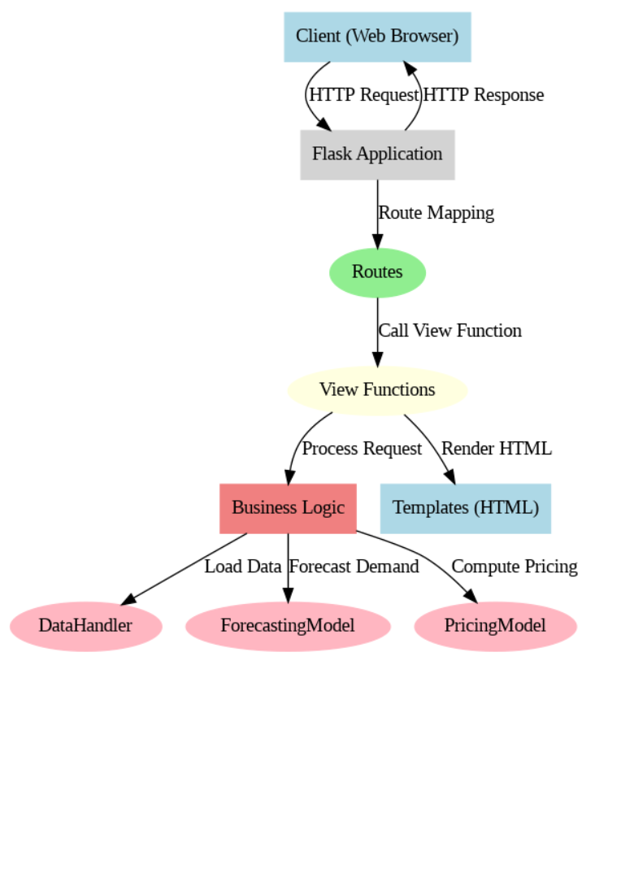
System Architecture

Slide 9
Modules
Data Ingestion and Preprocessing Module
Exploratory Data Analysis (EDA) Module
Demand Forecasting Module
Dynamic Pricing Module
Customer Segmentation Module
Web Application Module
Data Visualization Module
Deployment Module

Slide 10
Modules
Data Ingestion and Preprocessing Module
Tasks:
Loading datasets (restaurant sales, menu, users, orders, etc.)
Data cleaning (handling null values, removing duplicates)
Feature engineering (creating new features, one-hot encoding)
Data merging (combining datasets for analysis)
Data transformation (scaling, normalization)
Exploratory Data Analysis (EDA) Module
Tasks:
Statistical analysis of data
Visualizations (e.g., histograms, bar charts, time series plots)
Identifying trends, patterns, and anomalies
Correlation analysis

Slide 11
Modules
Demand Forecasting Module
Tasks:
Building predictive models (e.g., Decision Trees)
Forecasting weekly demand for each item
Generating demand forecasts for different date ranges
Evaluating model performance (e.g., accuracy, RMSE)
Dynamic Pricing Module
Tasks:
Analyzing historical sales data
Determining optimal pricing based on demand predictions
Implementing dynamic pricing strategies for different items
Displaying suggested prices on the web interface

Slide 12
Modules
Customer Segmentation Module
Tasks:
Analyzing customer data (gender, occupation, purchase history)
Segmenting customers based on purchasing patterns
Identifying target customer groups
Custom predictions based on user-specific scenarios
Web Application Module
Tasks:
Developing the Flask backend
Designing the HTML/CSS frontend
Integrating all functionalities (forecasting, pricing, segmentation)
Creating an intuitive user interface for restaurant managers
Handling user input and displaying results

Slide 13
Modules
Data Visualization Module
Tasks:
Visualizing forecasted demand and order distribution
Generating charts and graphs for stakeholder presentations
Creating interactive visualizations for the web application
Providing visual insights into sales trends and customer behavior
Deployment Module
Tasks:
Setting up a local server for the web application
Ensuring application accessibility through web browsers
Testing and validating the deployment
User interface optimization for ease of use

Slide 14
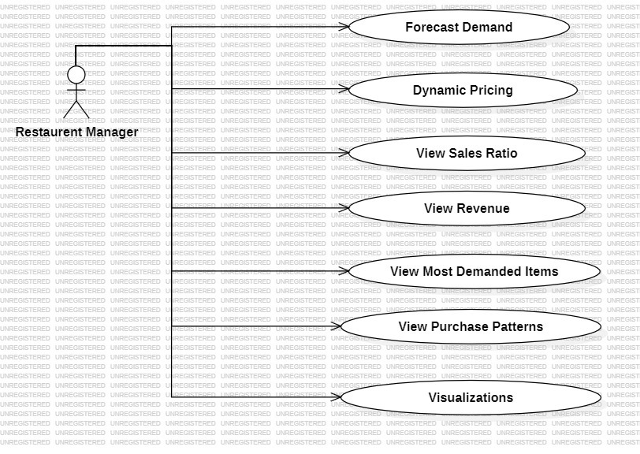
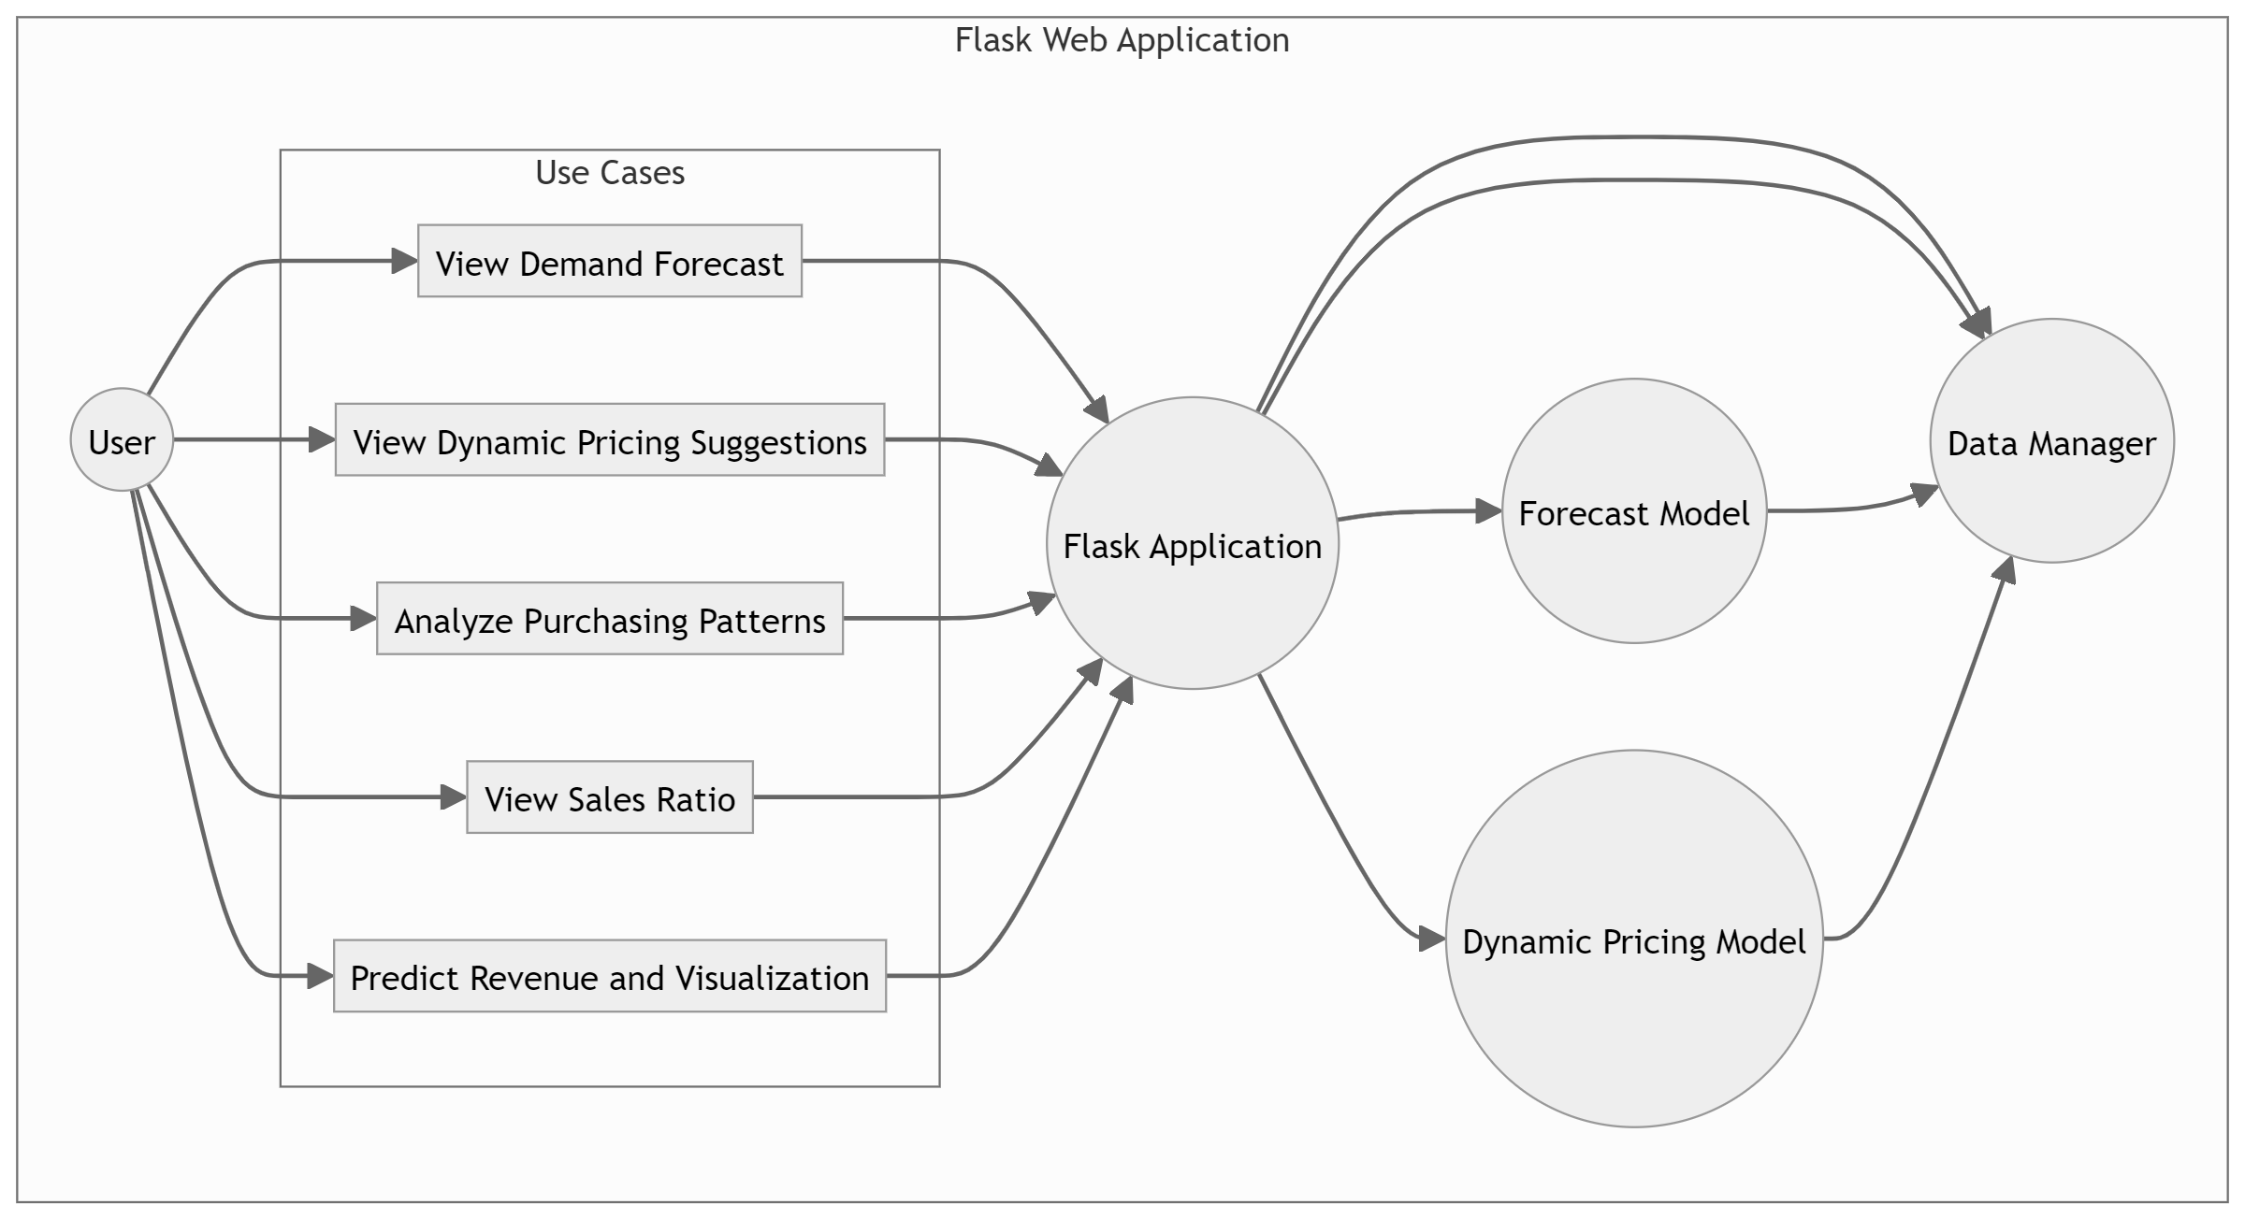
Modules Design

Slide 15
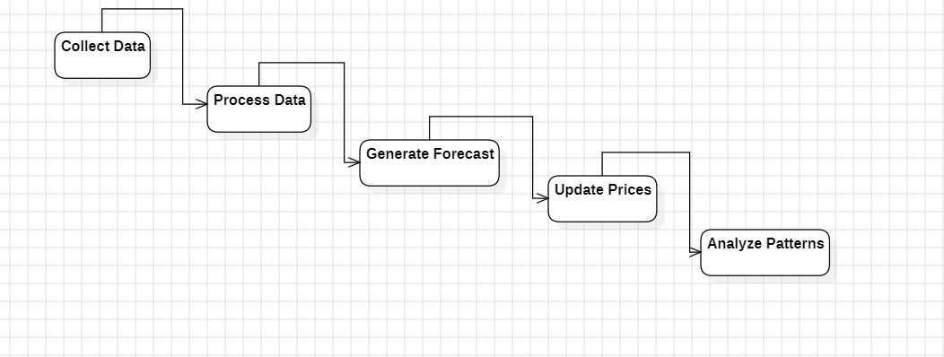
Modules Design

Slide 16
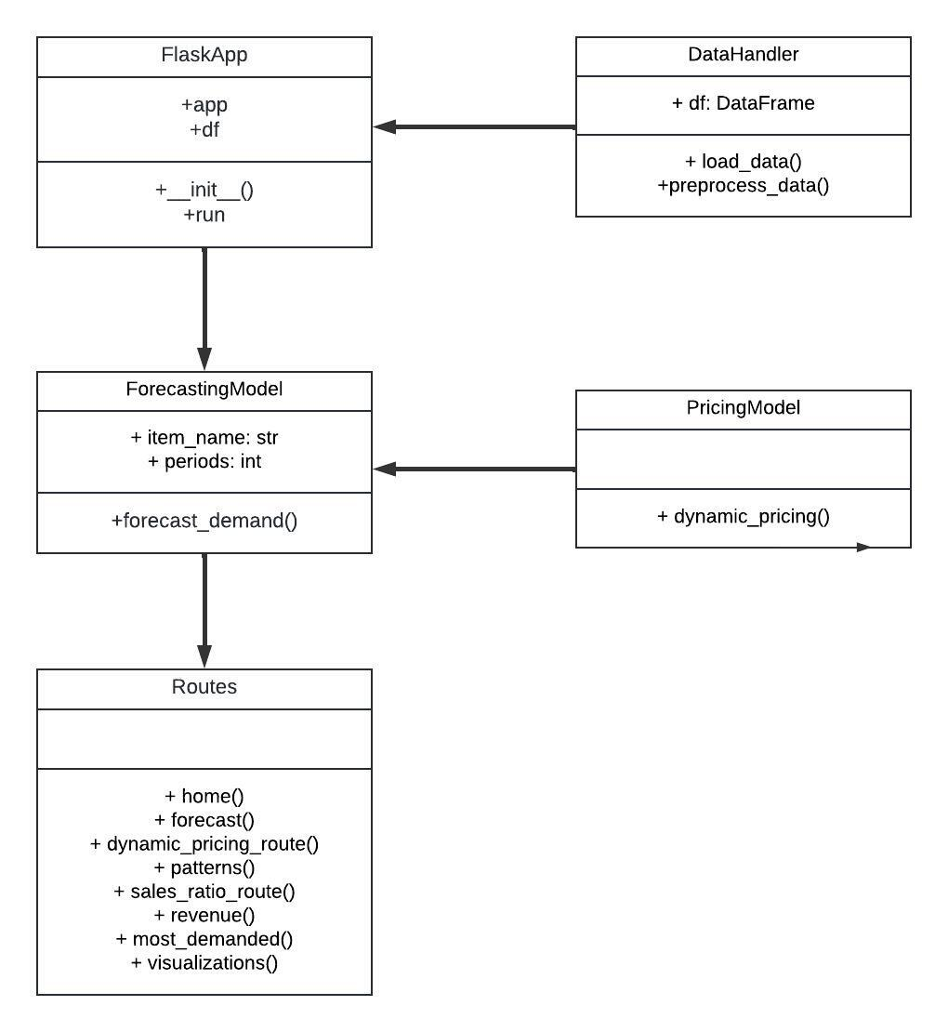
Modules Design

Slide 17
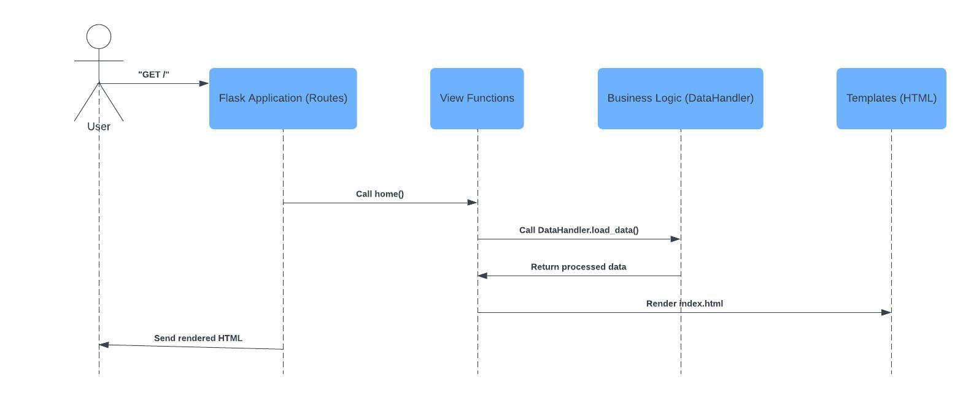
Modules Design

Slide 18
Description of Technologies used
1. Python
Description: Python is the main programming language used for the development of this project. It is known for its simplicity, readability, and extensive library support for data science, machine learning, and web development.
2. Flask
Description: Flask is a lightweight web framework for Python. It’s used here to create a web application that can render HTML templates and handle HTTP requests. Flask allows you to build dynamic web pages and is particularly well-suited for small to medium-sized projects.
3. Pandas
Description: Pandas is a powerful data manipulation and analysis library for Python. In this project, Pandas is used to load, preprocess, and manipulate the dataset. It provides data structures like DataFrames to work with structured data efficiently.
4. NumPy
Description: NumPy is a fundamental package for numerical computing in Python. It provides support for large multidimensional arrays and matrices, along with a collection of mathematical functions to operate on these arrays. NumPy is used here in conjunction with Pandas for data manipulation.

Slide 19
Description of Technologies used
5. scikit-learn
Description: scikit-learn is a machine learning library in Python. It provides simple and efficient tools for data mining and data analysis. In this project, the DecisionTreeRegressor from scikit-learn is used to build regression models for forecasting the number of orders and the quantity ordered for each item.
6. Jinja2
Description: Jinja2 is a templating engine for Python, used by Flask to dynamically generate HTML pages. It allows you to pass data from your Flask app to HTML templates and render them as fully functional web pages.
7. HTML/CSS
Description: HTML (HyperText Markup Language) is used to create the structure of the web pages, while CSS (Cascading Style Sheets) is used for styling the web pages to make them visually appealing. These technologies are utilized in the Flask templates to render the front-end of the application.
8. Datetime
Description: The datetime module in Python provides classes for manipulating dates and times. It is used in this project to handle date-related operations, such as forecasting future dates and formatting dates.

Slide 20
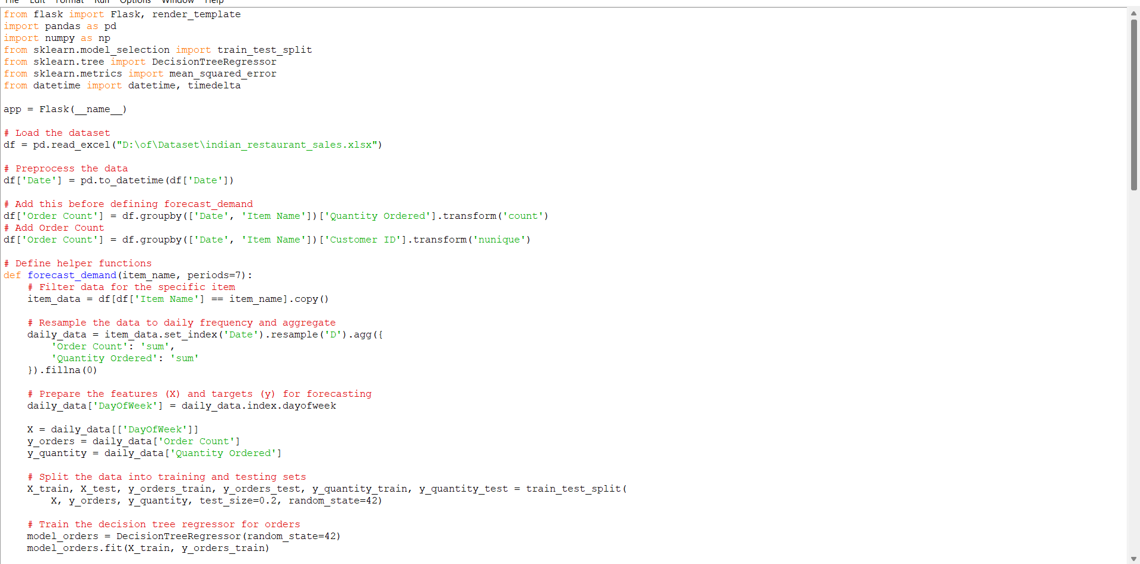
Implementation

Slide 21
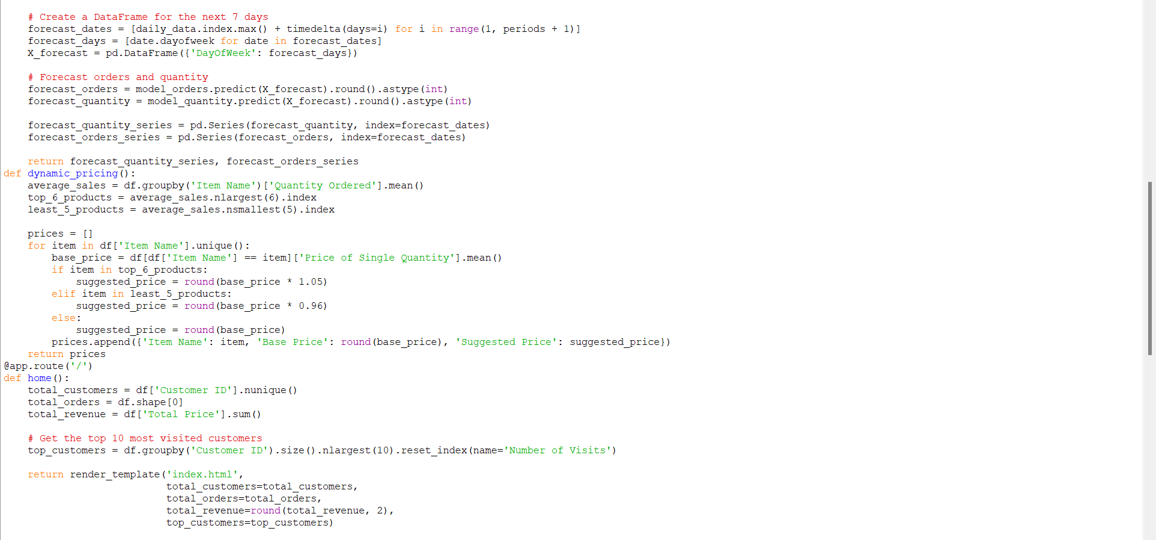
Implementation

Slide 22
Implementation
@app.route('/') def home(): total_customers = df['Customer ID'].nunique() total_orders = df.shape[0] total_revenue = df['Total Price'].sum() # Get the top 10 most visited customers top_customers = df.groupby('Customer ID').size().nlargest(10).reset_index(name='Number of Visits') return render_template('index.html', total_customers=total_customers, total_orders=total_orders, total_revenue=round(total_revenue, 2), top_customers=top_customers) @app.route('/forecast') def forecast(): items = df['Item Name'].unique() forecasts = {} fixed_dates = pd.date_range(start="2024-07-01", end="2024-07-07") for item in items: forecast_quantity, forecast_orders = forecast_demand(item) forecast_data = pd.DataFrame({ 'Date': fixed_dates, 'Forecast Quantity': forecast_quantity.reindex(fixed_dates, method='ffill').fillna(0).astype(int), 'Forecast Orders': forecast_orders.reindex(fixed_dates, method='ffill').fillna(0).astype(int) }) forecasts[item] = forecast_data.values.tolist() return render_template('forecast.html', forecasts=forecasts)

Slide 23
Implementation
@app.route('/dynamic_pricing') def dynamic_pricing_route(): prices = dynamic_pricing() return render_template('dynamic_pricing.html', prices=prices) @app.route('/patterns') def patterns(): patterns = df.groupby(['Gender', 'Customer Occupation', 'Item Name']).size().unstack(fill_value=0).idxmax(axis=1) return render_template('patterns.html', patterns=patterns) @app.route('/sales_ratio') def sales_ratio_route(): veg_sales = df[df['Item Category'] == 'veg']['Total Price'].sum() non_veg_sales = df[df['Item Category'] == 'non-veg']['Total Price'].sum() total_sales = veg_sales + non_veg_sales veg_ratio = round(veg_sales / total_sales, 2) non_veg_ratio = round(non_veg_sales / total_sales, 2) return render_template('sales_ratio.html', veg_ratio=veg_ratio, non_veg_ratio=non_veg_ratio) @app.route('/revenue') def revenue(): total_sales = df.set_index('Date').resample('D').sum()['Total Price'] model = ExponentialSmoothing(total_sales, trend='add', seasonal='add', seasonal_periods=7).fit() revenue_forecast = model.forecast(7) return render_template('revenue.html', revenue_forecast=round(revenue_forecast.sum(), 2))

Slide 24
Implementation
@app.route('/most_demanded') def most_demanded(): # Get the top 5 most demanded food items top_5_demanded_items = df.groupby('Item Name')['Quantity Ordered'].sum().nlargest(5).reset_index() return render_template('most_demanded.html', top_5_demanded_items=top_5_demanded_items) @app.route('/visualizations') def visualizations(): return render_template('visualizations.html') if __name__ == '__main__': app.run(debug=True)

Slide 25
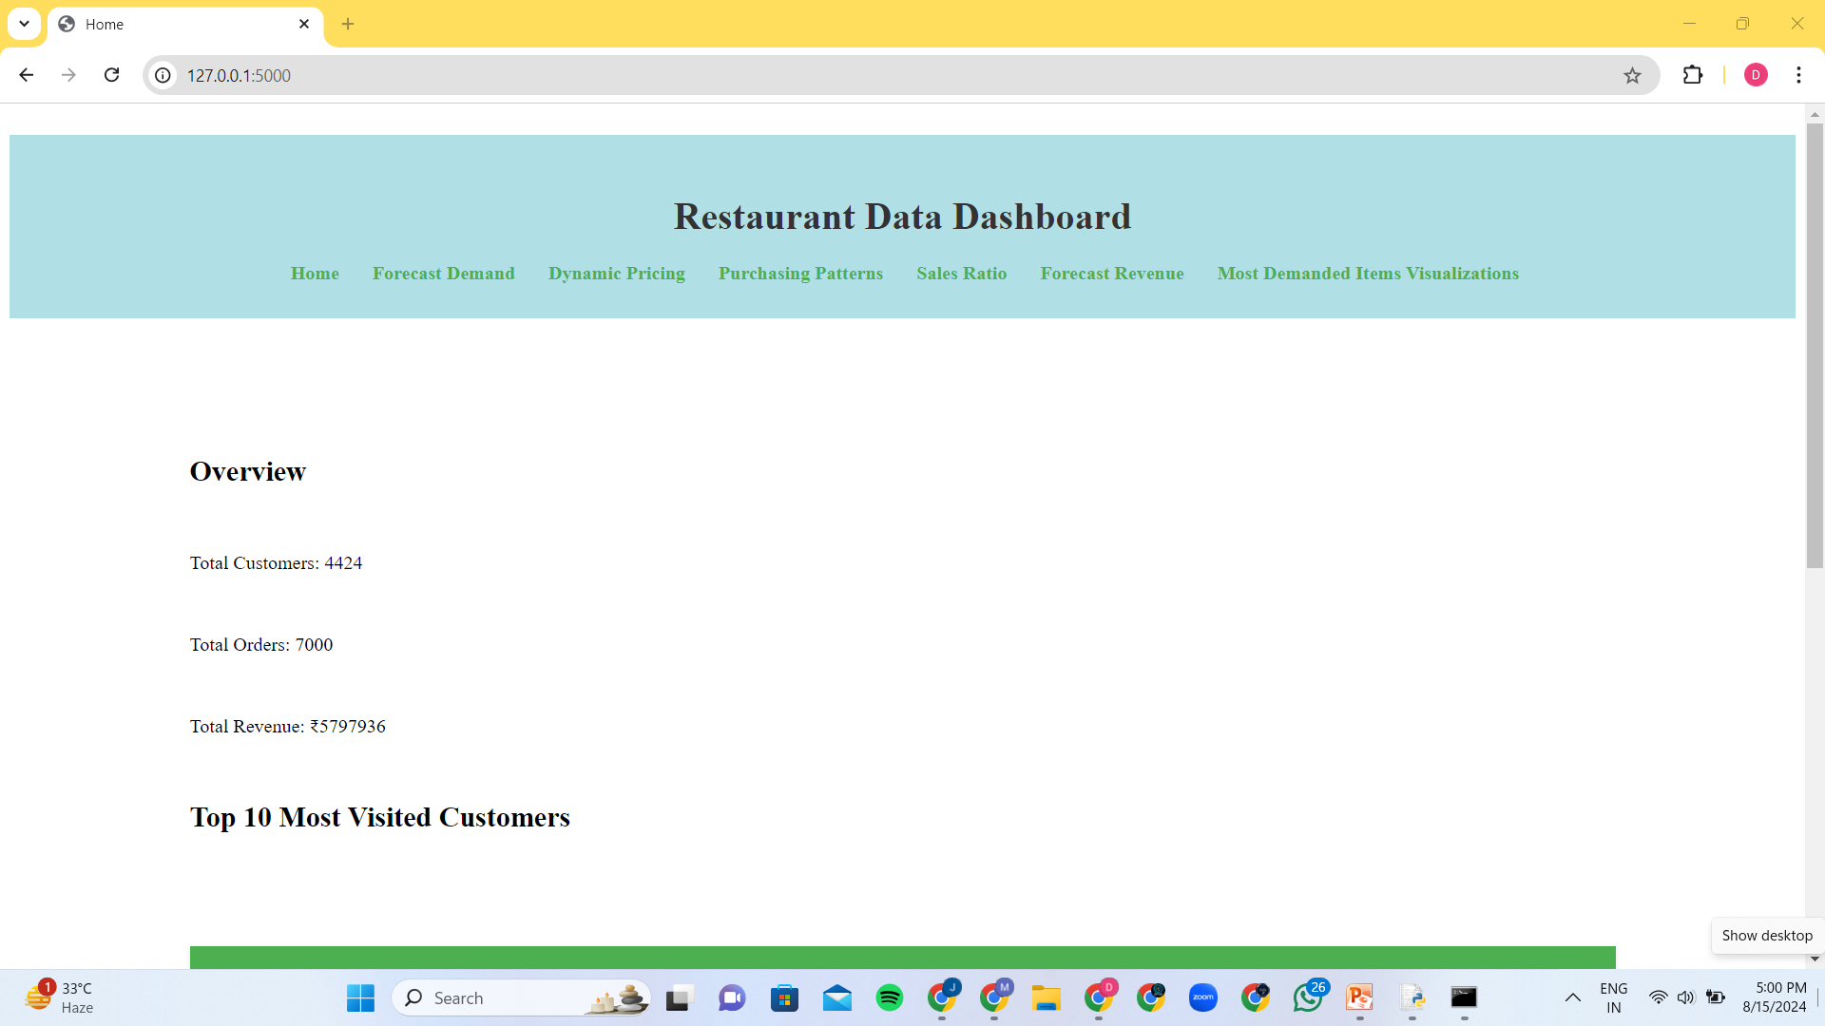
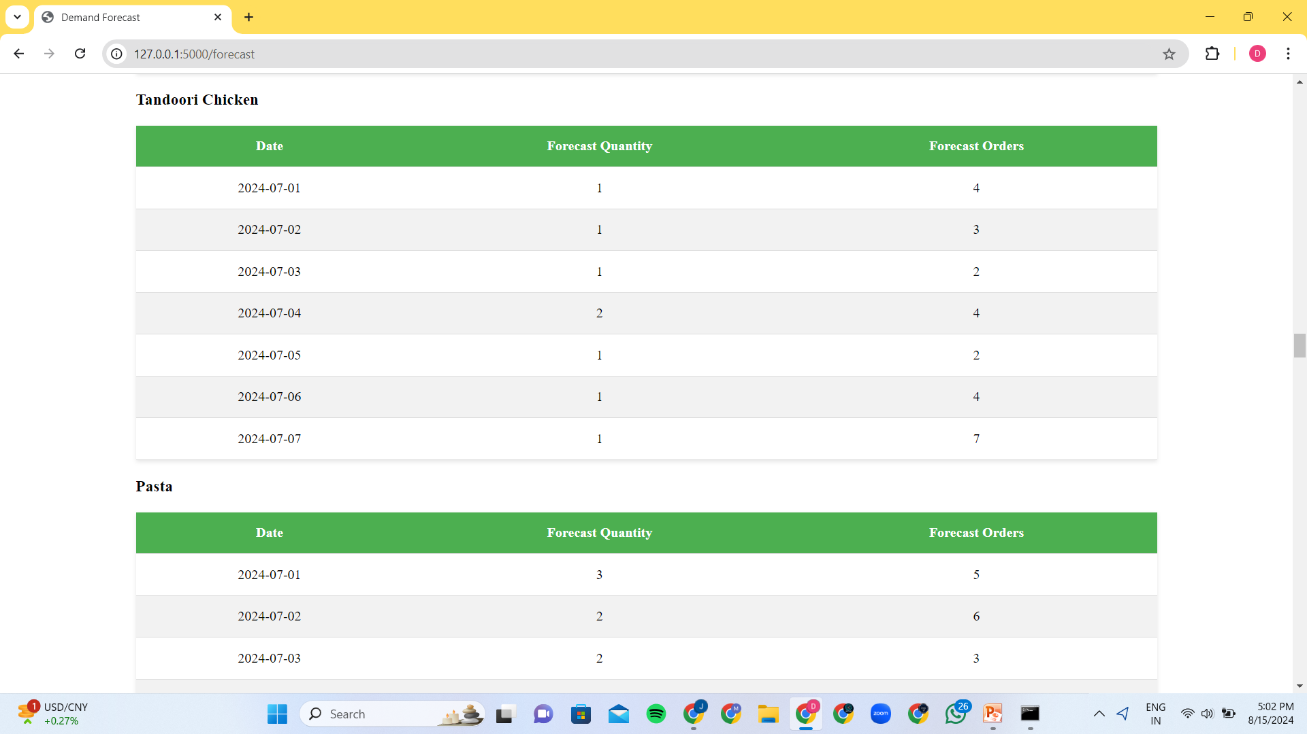
Experimental Results

Slide 26
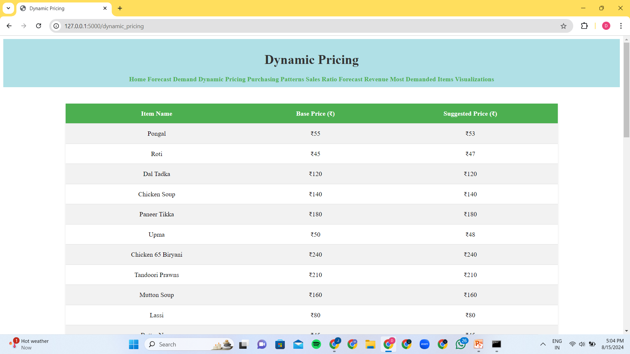
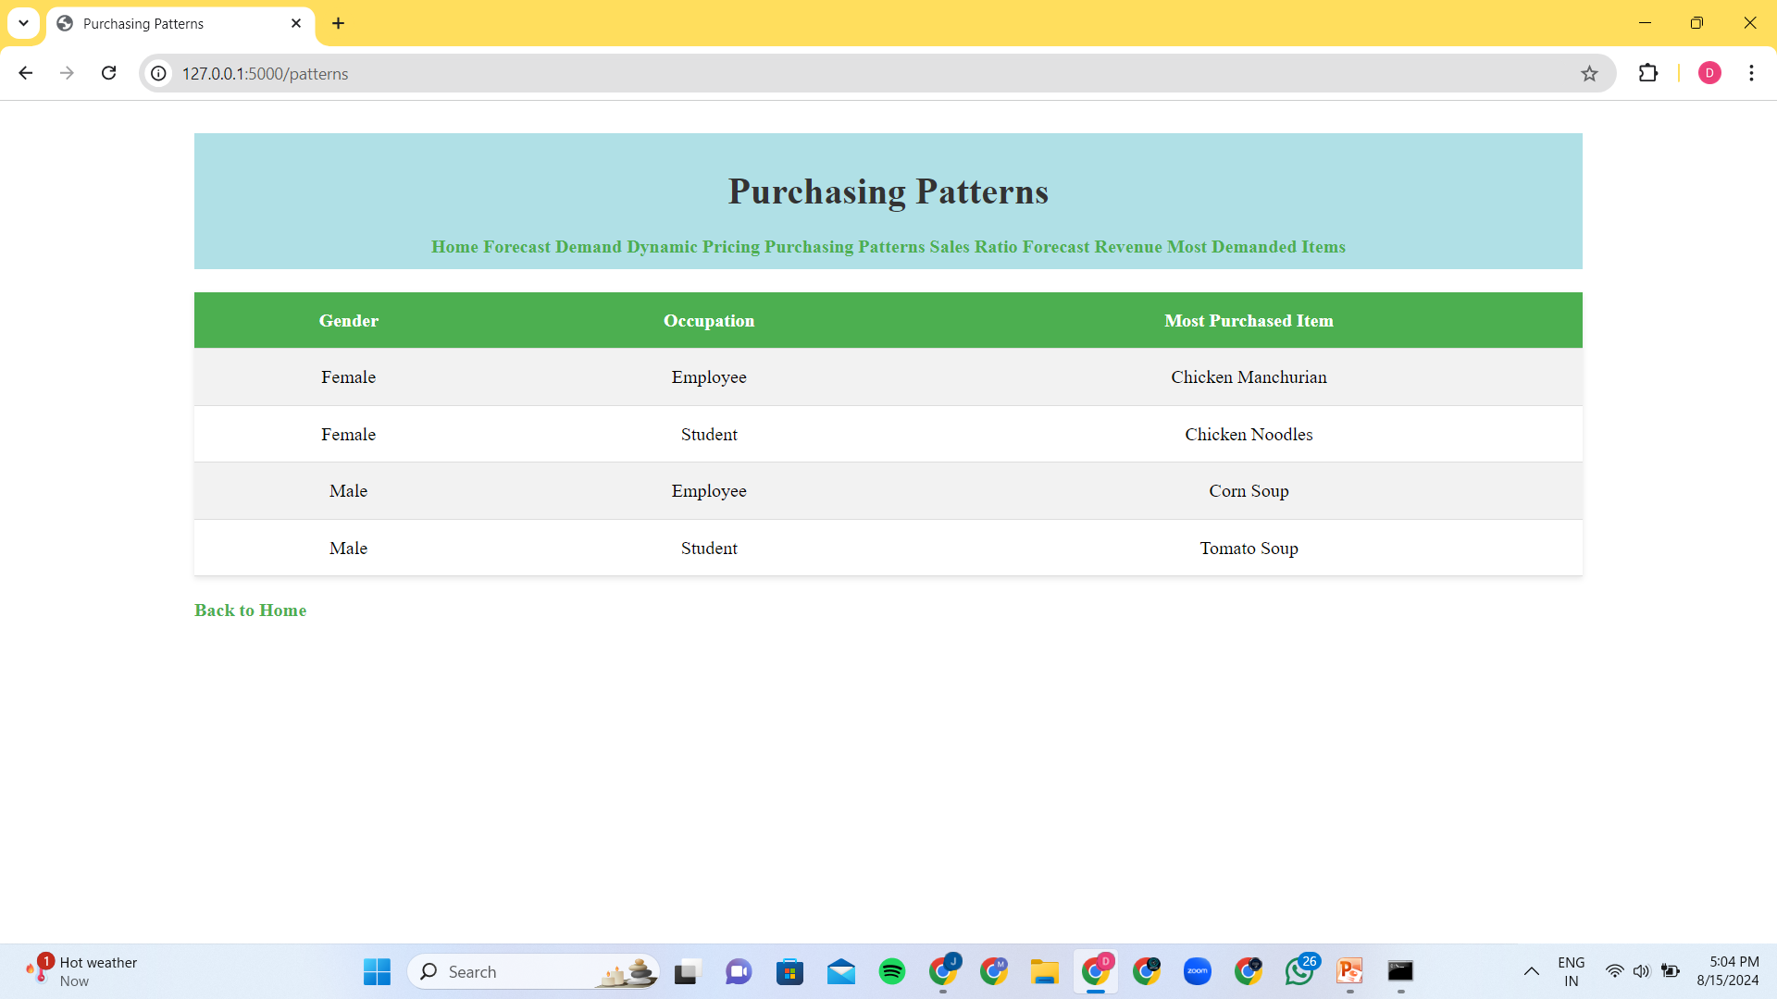
Experimental Results

Slide 27
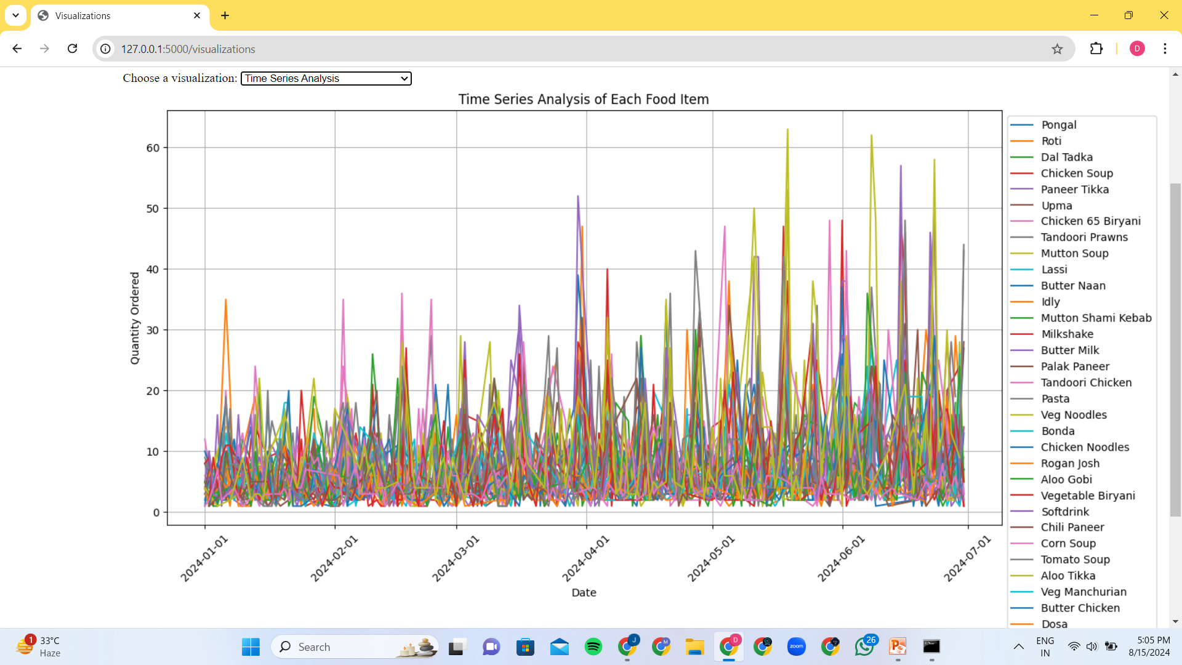
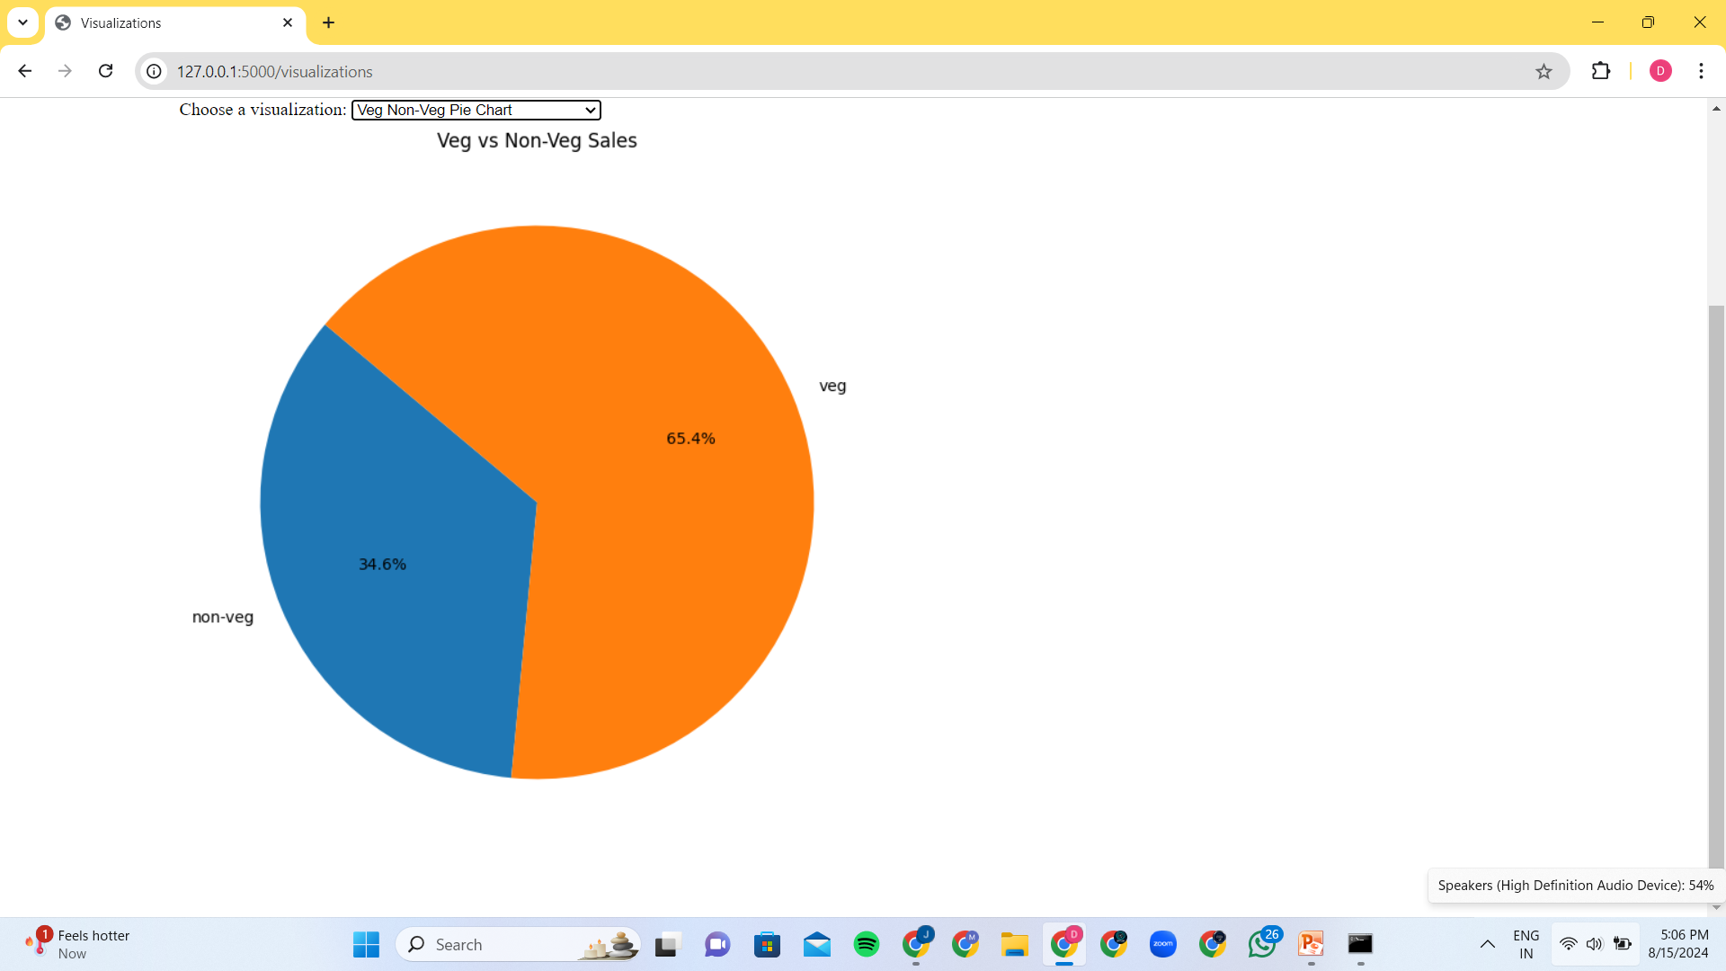
Experimental Results

Slide 28
Conclusion
This project successfully demonstrates the application of machine learning to optimize restaurant operations by accurately predicting weekly food orders, implementing dynamic pricing strategies, and analyzing customer purchasing patterns. The developed web application provides an intuitive interface for restaurant managers to make data-driven decisions, ultimately improving inventory management, reducing waste, and enhancing customer satisfaction. By leveraging predictive analytics, the project showcases the potential of AI to drive efficiency and profitability in the food service industry. The insights and tools provided by this system will enable restaurants to better anticipate demand, tailor their offerings, and maximize revenue.

Slide 29
References
"Sales Forecasting with Machine Learning: Techniques and Applications" International Journal of Forecasting
"Hands-On Machine Learning with Scikit-Learn, Keras, and TensorFlow" by Aurélien Géron
“Demand forecasting to improve customer loyalty and margins while minimizing food loss
”cropin

Slide 30
Thank you

